Slide 1


K.RAMAKRISHNAN COLLEGE OF TECHNOLOGY
(AUTONOMOUS), TRICHY.
DIGITAL CLOCK
PRESENTED
ASHMA BANU.M
2303811710422014
SUPERVISOR
Mr. M. Saravanan, M.E.,
AP/CSE.

Slide 2
PRESENTATION OVERVIEW
Objective
Project Introduction
Problem Statement
Methodologies (Programming concepts relevant to problem statement)
Architecture of the proposed system
List of Modules
Merits
Results and Discussion
Queries

Slide 3
OBJECTIVE
The primary objective of this Java program is to design and implement a functional digital clock that dynamically displays the current time in the format HH:mm:ss and updates in real-time every second.
The program demonstrates the use of core Java features, including Swing GUI for creating a user-friendly graphical interface, multithreading for ensuring smooth and continuous updates without freezing, and time management using SimpleDateFormat and Date for formatting and fetching the current time.
It incorporates event handling to manage periodic updates efficiently and provides an alternative console- based implementation for environments without graphical support.
This program serves as a practical example of integrating essential Java concepts such as GUI development, threading, and event-driven programming, making it both functional and educational for developers learning Java fundamentals.

Slide 4
PROJECT INTRODUCTION
The Digital Clock project is a Java-based application that provides users with a simple yet functional timekeeping tool. The project focuses on displaying the current time in real-time using a graphical user interface (GUI). It leverages the power of Java Swing for creating an intuitive interface and Java’s threading and event-handling capabilities to ensure accurate and dynamic time updates.
This project serves as an excellent demonstration of how programming concepts such as GUI design, event-driven programming, and multithreading can be used to create practical applications. By building this project, developers gain hands-on experience in integrating various Java components and implementing real-time functionality.
The Digital Clock is designed to be lightweight, user-friendly, and visually appealing, making it a practical desktop utility. Additionally, it lays the foundation for more advanced applications like alarm clocks, countdown timers, or world clocks.

Slide 5
PROBLEM STATEMENT
In the modern era, digital devices are integral to our daily routines, yet there is a lack of simple, standalone, and customizable desktop applications for timekeeping. Many existing solutions are either integrated into operating systems with limited flexibility or come as complex third-party applications with unnecessary features.
The challenge is to develop a lightweight, platform-independent Digital Clock application that provides accurate, real-time time updates in a user-friendly interface. The clock should focus on simplicity, reliability, and ease of use while being adaptable for future enhancements such as alarms, timers, or date displays.
By solving these issues, the Digital Clock project aims to deliver a practical and accessible tool for everyday timekeeping needs.

Slide 6
METHODOLOGIES
Requirement Gathering
Identify the core feature: displaying the current time in real-time.
Choose Java as the programming language and Swing for the GUI.
Design
Plan a simple graphical user interface (GUI) with a large clock display.
Use basic components like JLabel for displaying time and JFrame for the main window.
Implementation
Fetch the current time using Java's Date and SimpleDateFormat classes.
Use a Timer or thread to refresh the time every second.

Slide 7
METHODOLOGIES
Testing
Run the program to ensure the time updates accurately in real-time.
Check for compatibility across operating systems (e.g., Windows, macOS, Linux).
Optimization
Ensure the program runs smoothly without consuming excessive resources.
Adjust the interface for readability and aesthetic appeal.
Deployment
Package the application into an executable JAR file.
Provide usage instructions for easy installation and use.

Slide 8
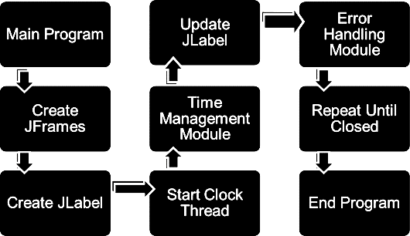
ARCHITECTURE OF THE PROPOSED SYSTEM

Slide 9
LIST OF MODULES
MODULE DESCRIPTON
Threading Module
The Threading Module in the provided program refers to the use of Java's multithreading capabilities to ensure the digital clock updates at regular intervals. In the given console- based program, Thread.sleep() is used within an infinite loop to pause the execution for 1 second, allowing the time to be updated in real-time.
Time Management Module
The Time Management Module in the provided program handles retrieving, formatting, and displaying the current system time in real-time. It ensures that the digital clock accurately reflects the current time and updates at regular intervals. This module ensures the clock maintains synchronization with the system time and provides a seamless real- time experience for the user

Slide 10
LIST OF MODULES
MODULE DESCRIPTON
Error Handling Module
The Error Handling Module in the provided program ensures that the program gracefully manages exceptions, particularly those that might occur during execution, such as interruptions to the thread's sleep state. By incorporating proper exception handling, the program remains robust and user-friendly, even in the presence of runtime anomalies.
Event Handling Module
The Event Handling Module in the context of the provided digital clock program is used primarily in GUI-based versions (e.g., using Swing or AWT). Event handling allows the program to respond to specific user actions or system-generated events, such as updating the clock display every second or closing the application window.

Slide 11
MERITS
Real-Time Functionality
Displays accurate, dynamically updated time without delays.
User-Friendly Interface
Provides a clean, simple, and intuitive GUI suitable for all users.
Lightweight Application
Consumes minimal system resources, making it efficient and fast.
Cross-Platform Compatibility
Works seamlessly on multiple operating systems (Windows, macOS, Linux) due to Java's platform independence.

Slide 12
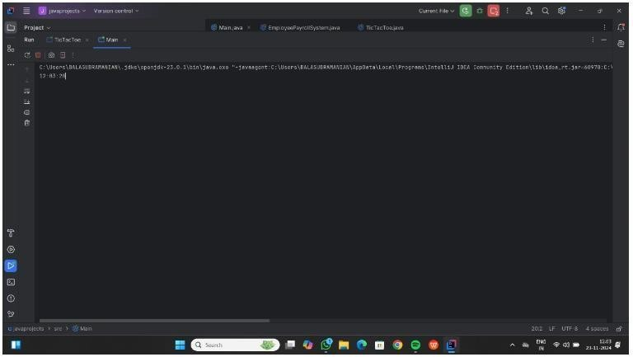
RESULTS AND DISCUSSION

Slide 13
THANK YOU

